Slide 1

20 Newsgroups Text Classification AML-2304 Natural Language Processing
Presented by:
Kishan Lakhatariya (C0849341)
Harshkumar Patel (C0848343)
Mohammaddin Masbi (C0850500)
Kanan Trivedi (C0851492)
Professor: Harriet Huang

Slide 2
Contents
Abstract
Dataset
Exploratory Data Analysis (EDA)
Data Preprocessing
Tokenization
Stemming
Train and Test
Model Training
Classification Report
Confusion Matrix

Slide 3
Abstract
Analyzed and processed text data of 20 newsgroups text datasets with different techniques to get meaningful words from the dataset and converted them into word vectors using two different word embedding strategies, TF-IDF and Word2Vec, and trained the vectorized data using three different machine learning models, from all the training we got maximum training accuracy of 96% and testing accuracy of 71% using Support Vector Machine Classifier with the vectorizer TF-IDF.
It is essential to classify the new topics for the chatbots and AI assistants to give recommendations based on the reader’s interest in addressing this problem; we have chosen the news dataset with 20 different topics as labels and trained the model to predict the news text.

Slide 4
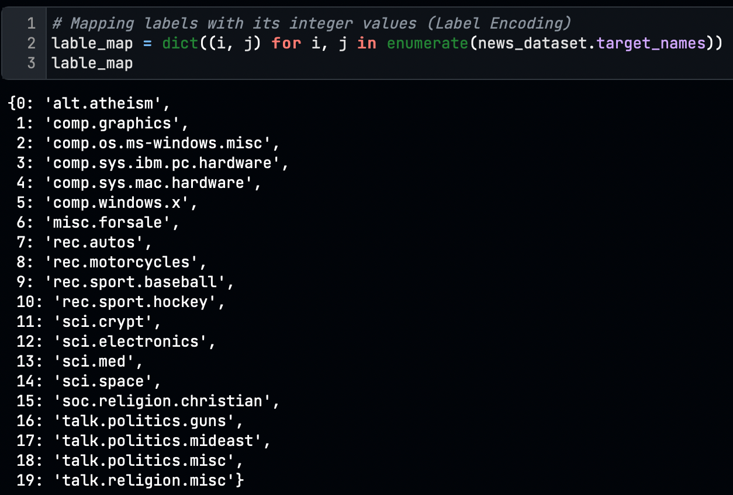
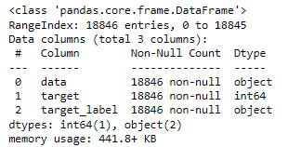
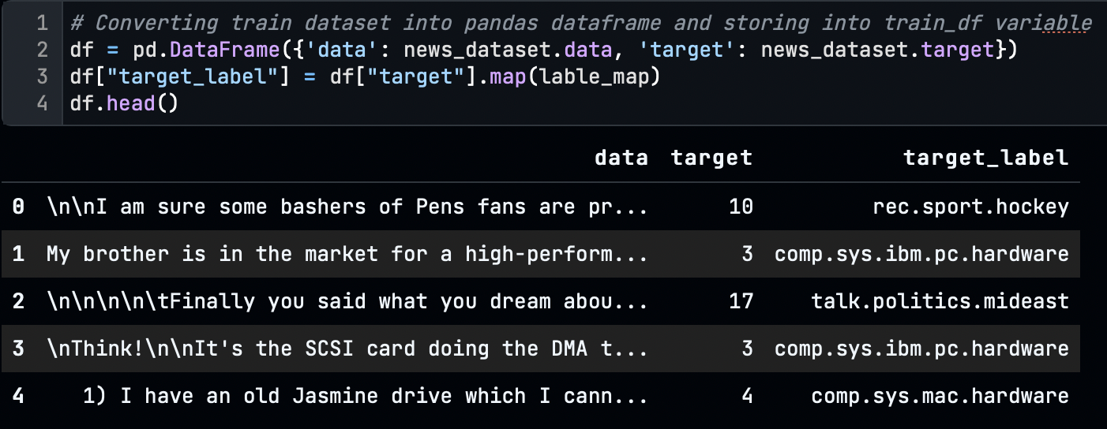
Dataset
We have used the fetch_20newsgroups API to get the dataset which contains 18846 samples with 2 columns of data and a target.
As the target is the integer value, we have mapped the target_lables with it for further analysis
The initial shape of the data is 18846 rows and 3 columns.
Notes:
When conducting research, it is easy to go to one source: Wikipedia. However, you need to include a variety of sources in your research. Consider the following sources:
Who can I interview to get more information on the topic?
Is the topic current and will it be relevant to my audience?
What articles, blogs, and magazines may have something related to my topic?
Is there a YouTube video on the topic? If so, what is it about?
What images can I find related to the topic?

Slide 5
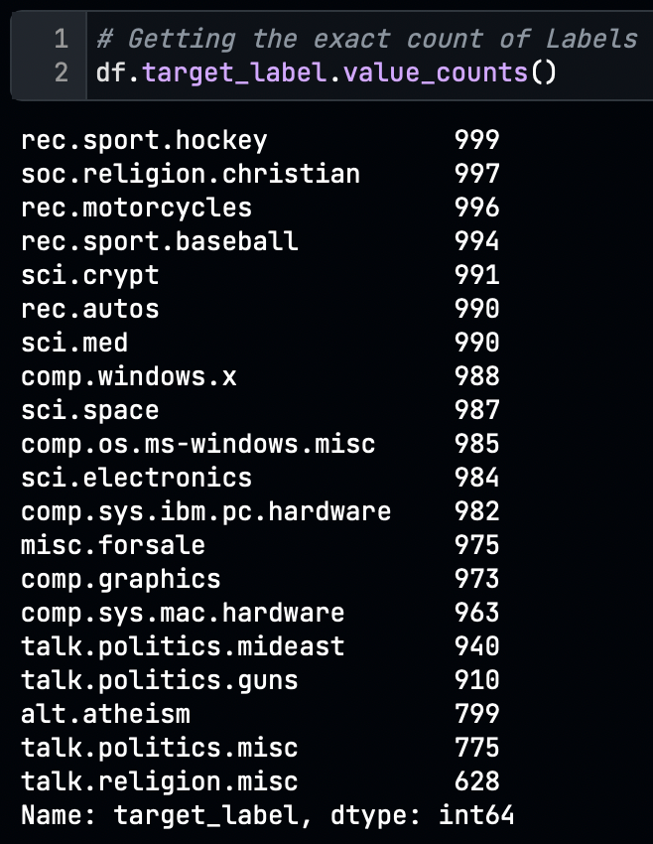
Exploratory Data Analysis (EDA)
We have three data initially
i. Data: which contains the text of the news.
ii. Target: which is the integer value of labels.
iii. Target_labels: which is the string of the labels.
The total count and frequency of the labels average are 750+.
Notes:
Once you find your sources, you will want to evaluate your sources using the following questions:
Author:
Who is the author?
Why should I believe what he or she has to say on the topic?
Is the author seen as an expert on the topic? How do you know?
Current:
How current is the information in the source?
When was the source published?
Is the information out-of-date?
Accuracy:
Is the content accurate?
Is the information presented objectively? Do they share the pros and cons?

Slide 6
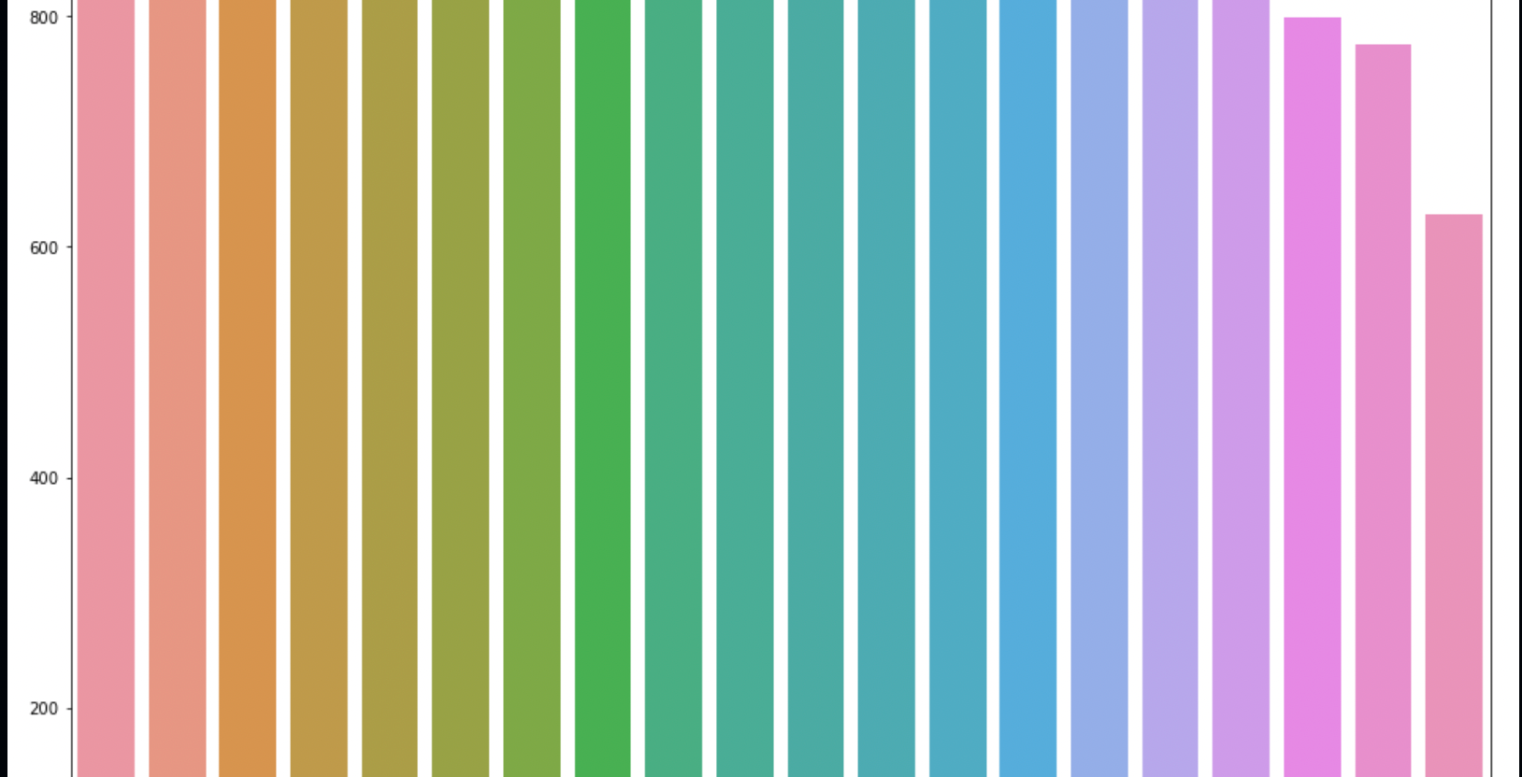
Notes:
Once you find your sources, you will want to evaluate your sources using the following questions:
Author:
Who is the author?
Why should I believe what he or she has to say on the topic?
Is the author seen as an expert on the topic? How do you know?
Current:
How current is the information in the source?
When was the source published?
Is the information out-of-date?
Accuracy:
Is the content accurate?
Is the information presented objectively? Do they share the pros and cons?

Slide 7
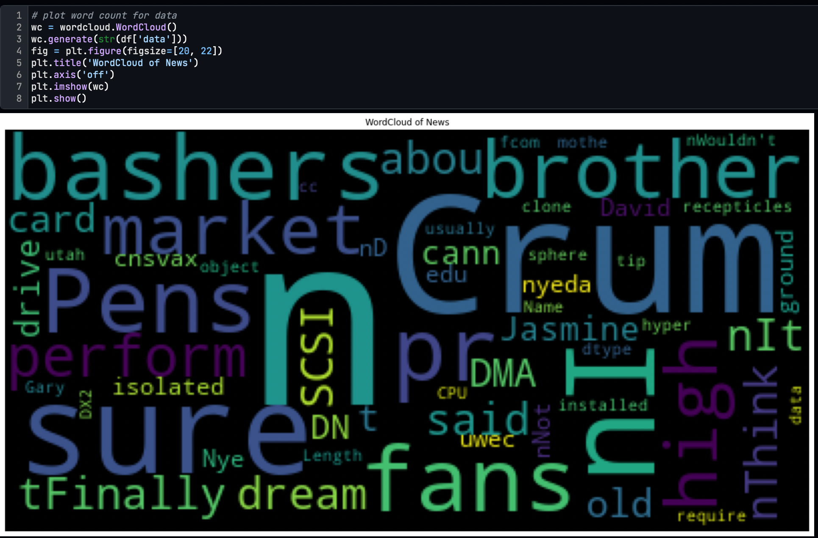
Pre-processing
We performed pre-processing steps to convert text data into meaningful data to make the computer understandable the text data.
First, we plot the word cloud to know the frequency of the words, and we discover that many un-useful words have higher frequencies than essential words.
Here we can see that the occurrence of the “n” is higher in the text data.
Notes:
After consulting a variety of sources, you will need to narrow your topic. For example, the topic of internet safety is huge, but you could narrow that topic to include internet safety in regards to social media apps that teenagers are using heavily. A topic like that is more specific and will be relevant to your peers. Some questions to think about to help you narrow your topic:
What topics of the research interest me the most?
What topics of the research will interest my audience the most?
What topics will the audience find more engaging? Shocking? Inspiring?

Slide 8
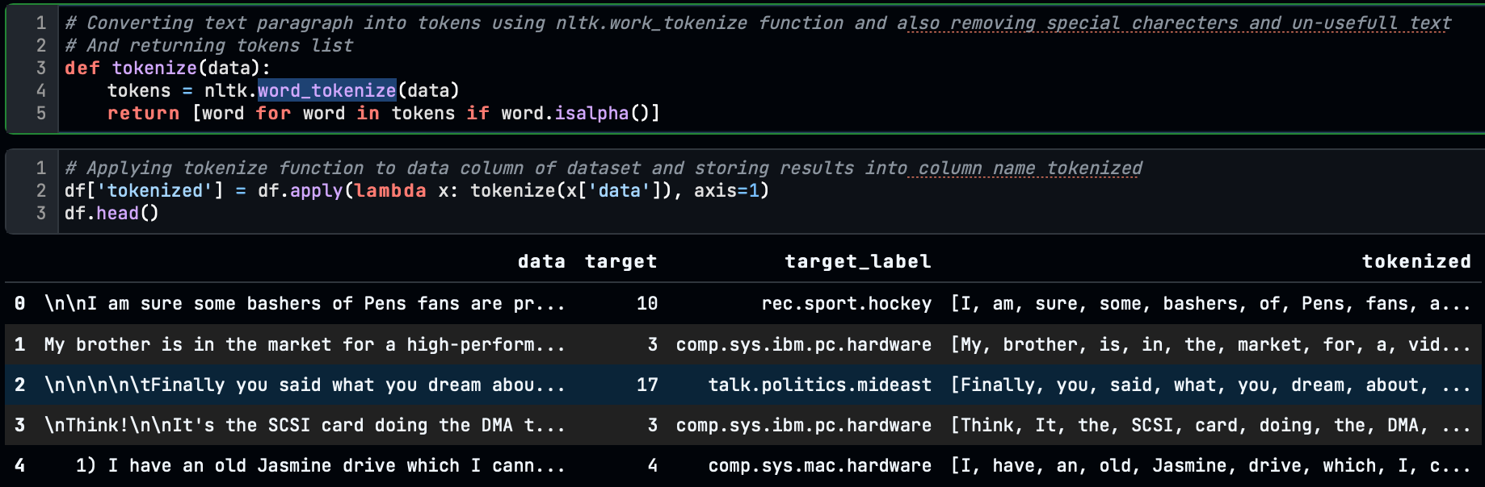
Tokenizing
So, we must perform data cleaning, including removing symbols and ASCII characters, stopping word removal, steaming and lemmatizing.
We tokenized the data using NLTK’s word_tokenize function and stored all tokenized words in separate columns

Slide 9
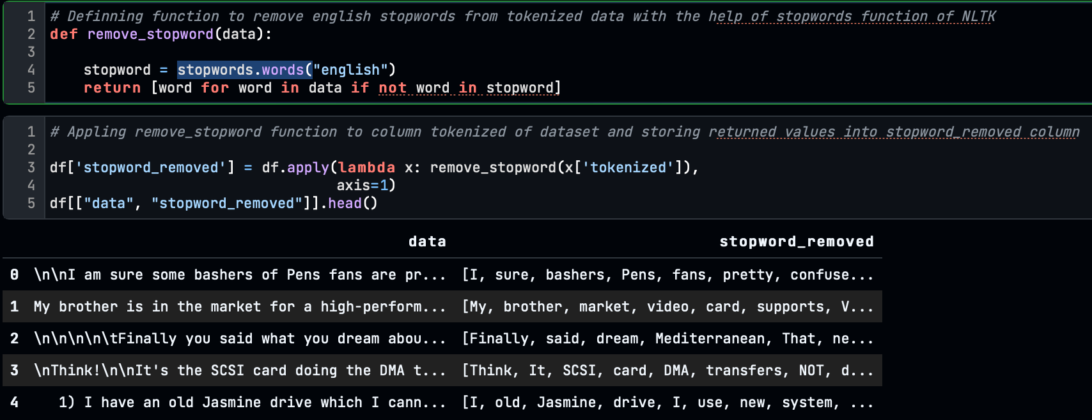
Removing Stop Words
We applied the English stop word removal on the tokenized word using “stopwords.words()” of the NLTK function.

Slide 10
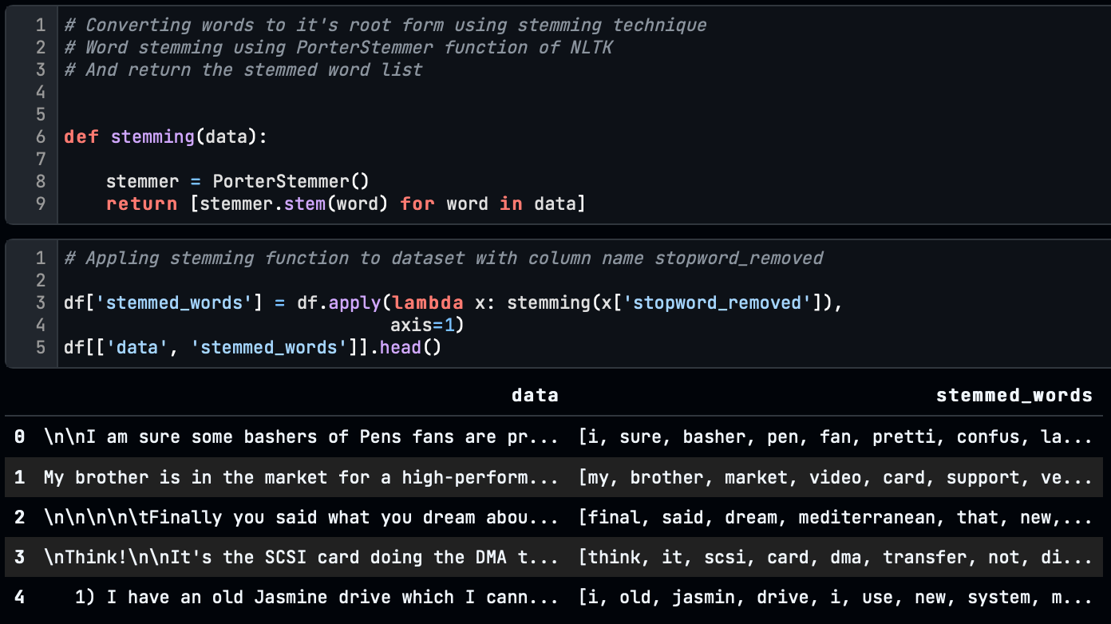
Stemming
After removing the stop words, we convert the words to their root form, which is called stemming.
Notes:
Now, that you have narrowed your topic, you will want to organize your research in a structure that works. There are some common organizational patterns based on the kind of research you are doing.
Organizational Structures:
Cause and Effect- this kind of structure is great for explaining the causes and effects of a topic
Compare and Contrast- in this pattern you highlight the similarities and differences of the topic
Explain process- this structure is great for outlining a series of steps to follow;
Definition- if you want to make sure your audience understands what something is using illustrations, meanings, clarifying misconceptions, you may want to use this structure
Classification- a common organizational structure is grouping like topics or facts from the research together. For instance, in the internet safety about social media apps, you may organize the research where you look at each social media app one at a time

Slide 11
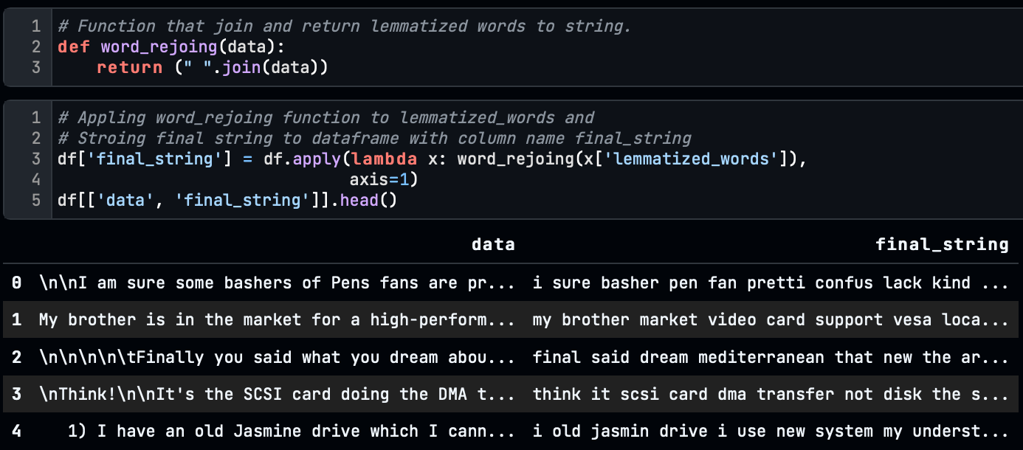
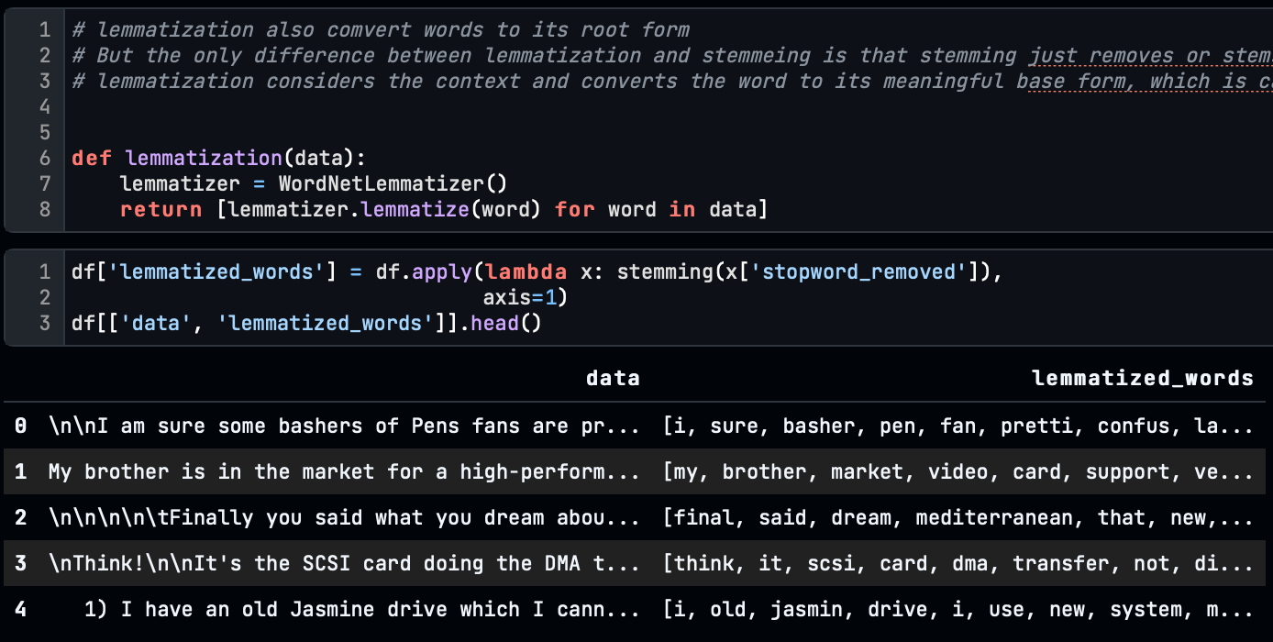
Lemmatization
The only difference between lemmatization and stemming is that stemming removes or stems the last few characters of a word, often leading to incorrect meanings and spelling
Lemmatization considers the context and converts the word to its meaningful base form, which is called Lemma.
The final step of the preprocessing is the joining of the lemmatized_words into a string.

Slide 12
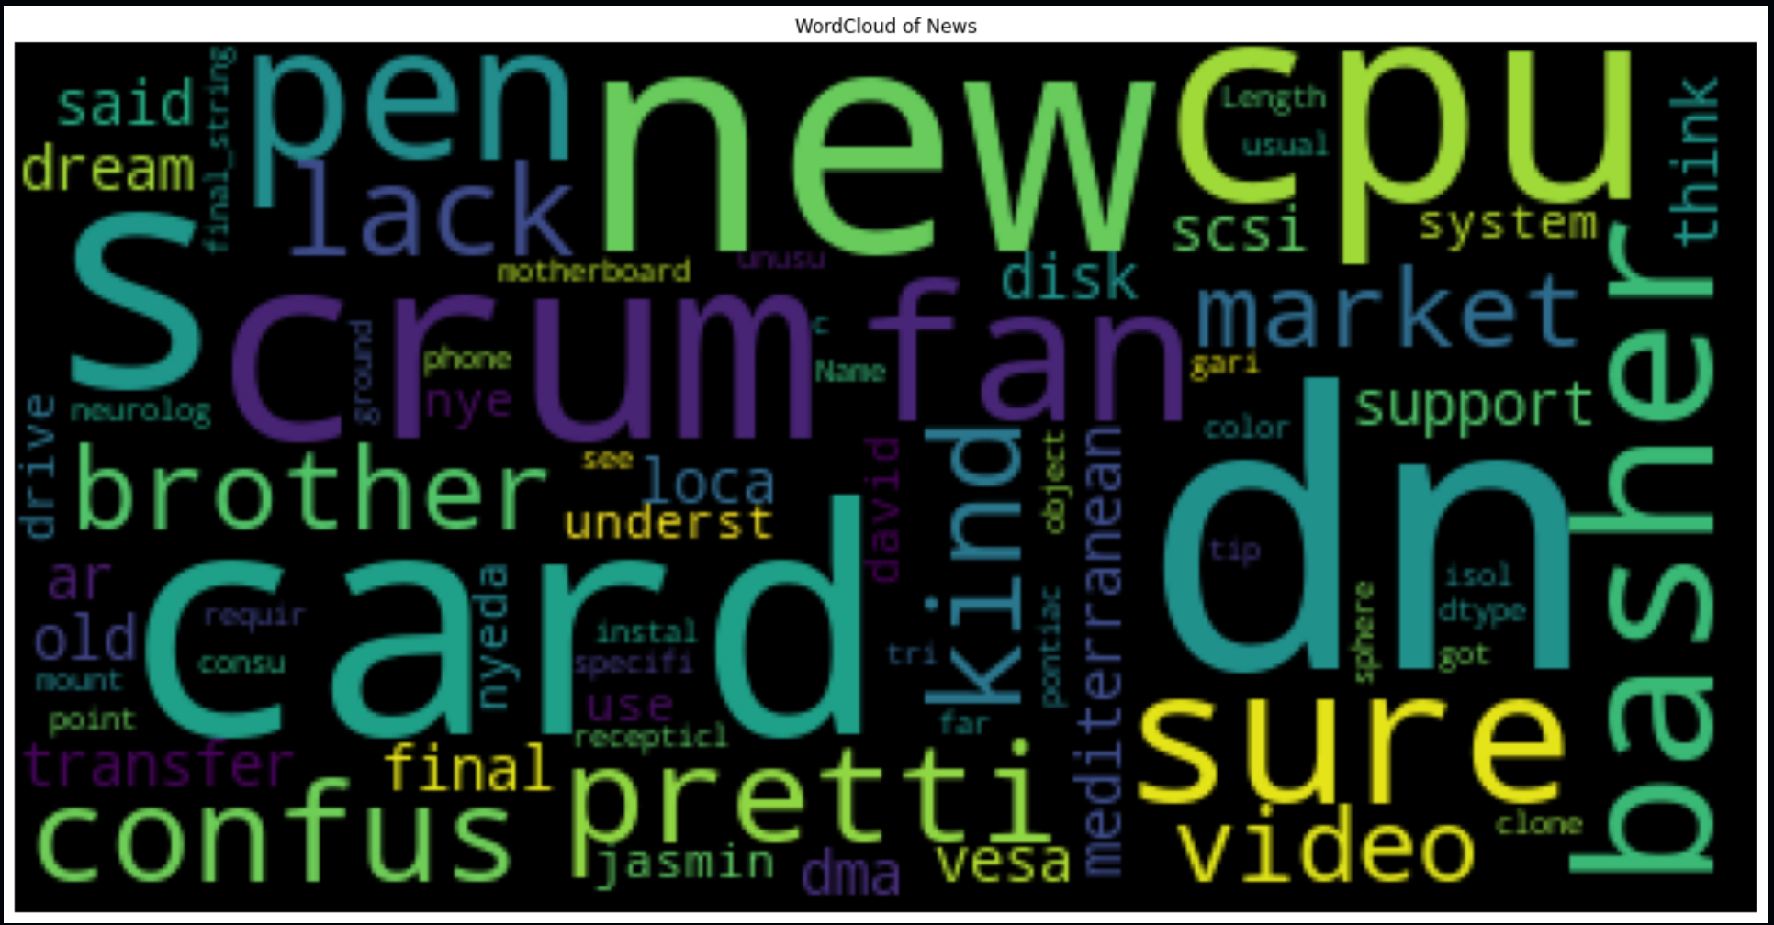
WordCloud
After preprocessing, we again generated a word cloud on final_string, and we got a clean and clear view of the words.

Slide 13
Feature Extraction
Extracting features from the text data is called word vectorization or word embeddings. This is a very crucial part of Natural Language Processing because this feature vector will go into the model training. If this is not done correctly, the model will lead to misprediction.
Word Vectorization is the technique of converting words to numerical form to perform model training on text-based data.
For this problem, we have used two-word vectorizing techniques.
TF-IDF
Word2vec

Slide 14
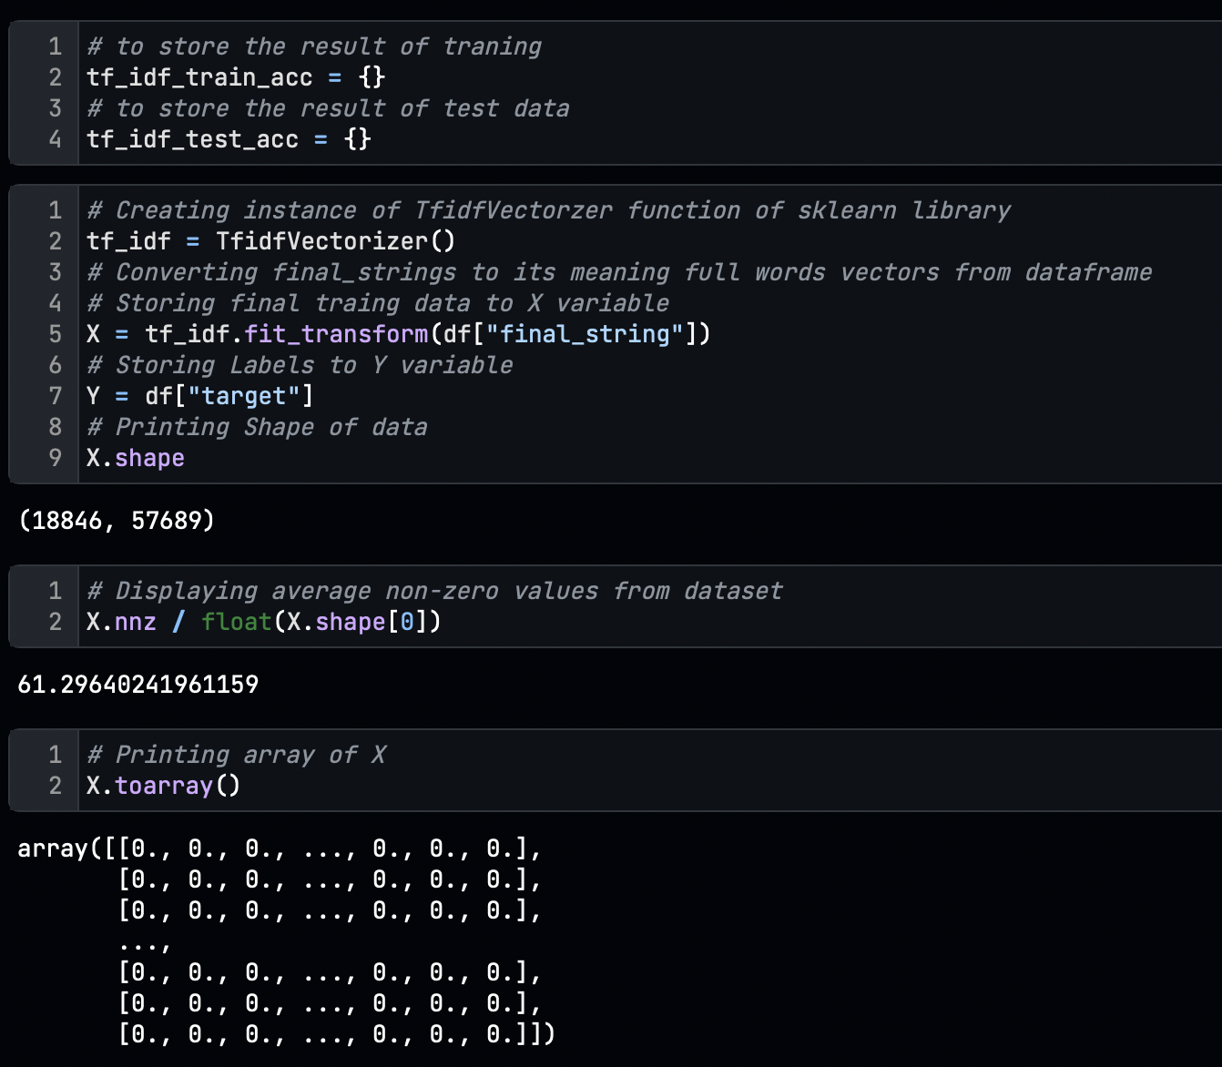
TF-IDF
Term Frequency-Inverse Document Frequency is a statistical measure that evaluates how relevant a word is to a document in a collection of documents.
This is done by multiplying two metrics: how many times a word appears in a document and the inverse document frequency of the word across a set of documents.
Here we have used the TfidfVectorizer class of the Sklearn library to convert the words to vectors.
Here we discovered that from all features, 61.29% of data is none zero, and 39% of features contain zeros because of the uneven length of news text.

Slide 15
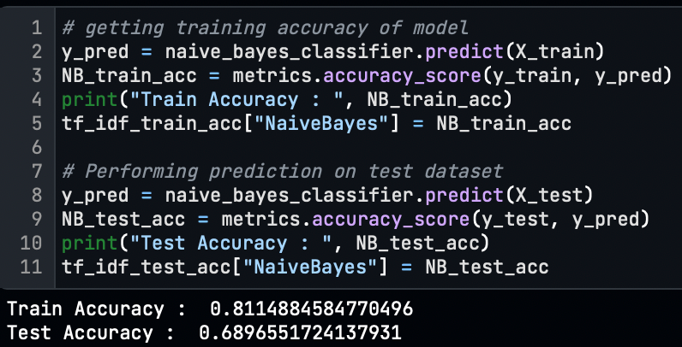
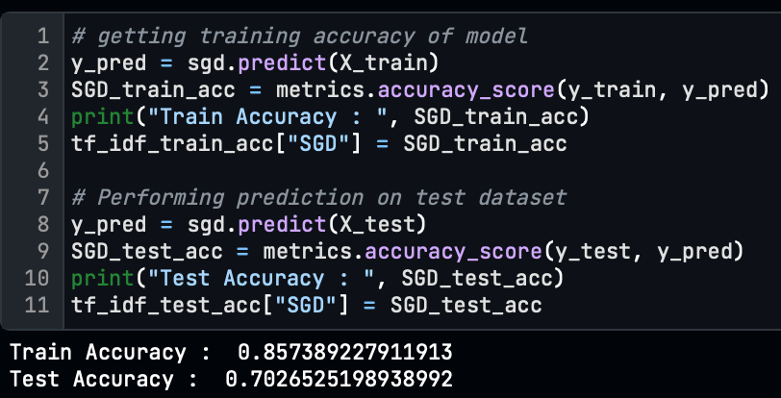
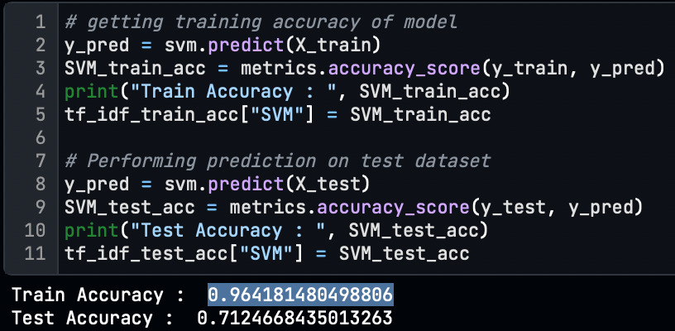
To train and evaluate the model, we split the dataset into train-test with a ratio of 80-20%. h. We have trained the model with three different classifiers.
Naive Bayes Classifier
SGD Classifier
Support Vector Machine(SVM) Classifier

Slide 16
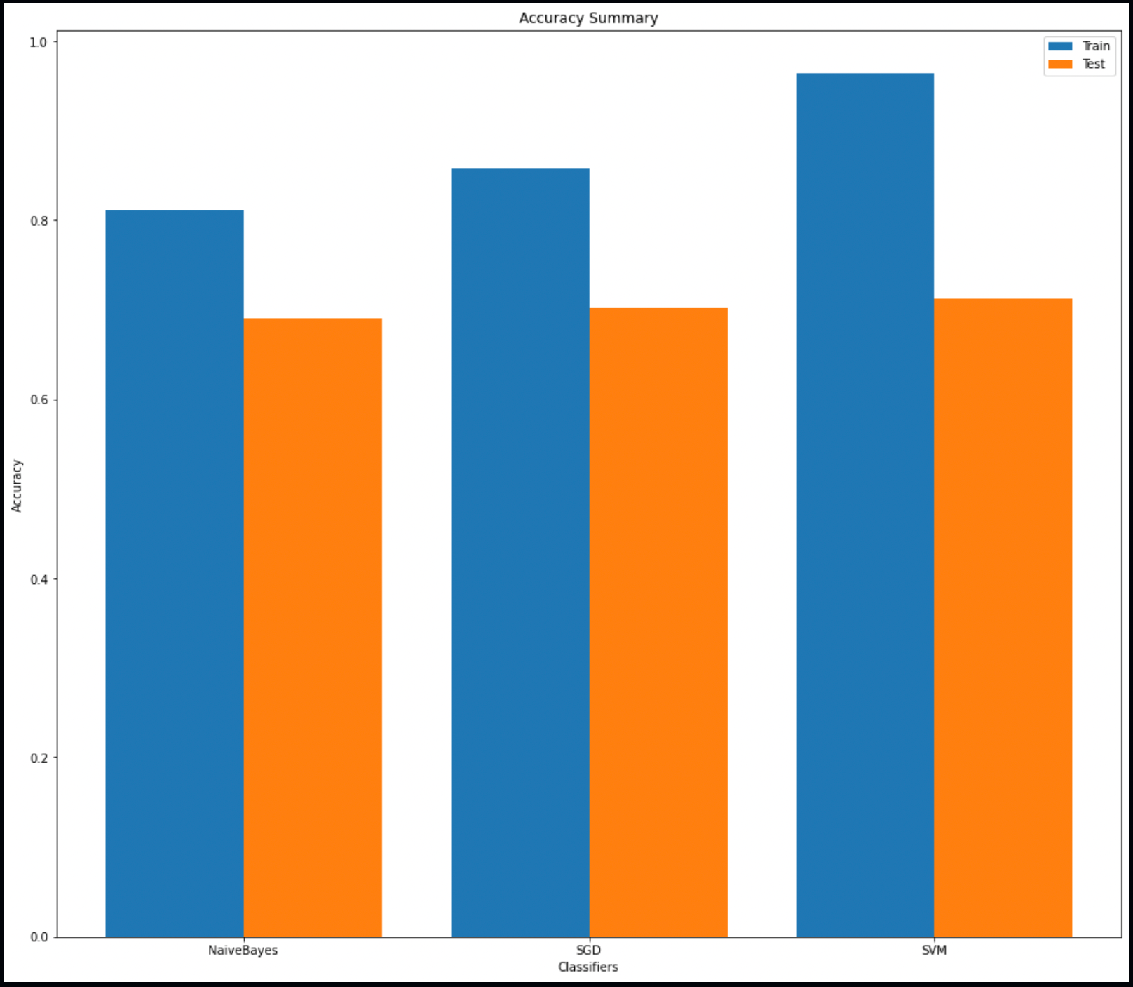
Train-Test Summary
From all three classification models, Support Vector Machine Classifier performed well with train accuracy of 96% and test accuracy of 71% other than Naïve Bayes with 81%-69% Train-Test and SGD with 85%-70% train-test accuracy.

Slide 17
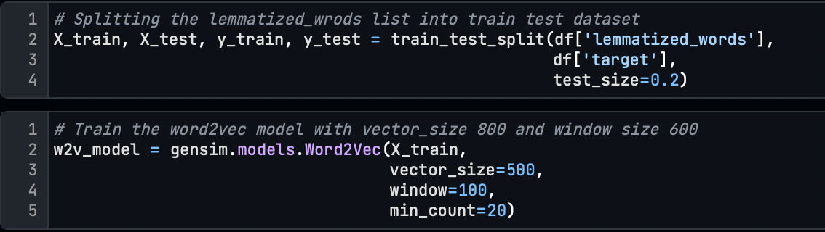
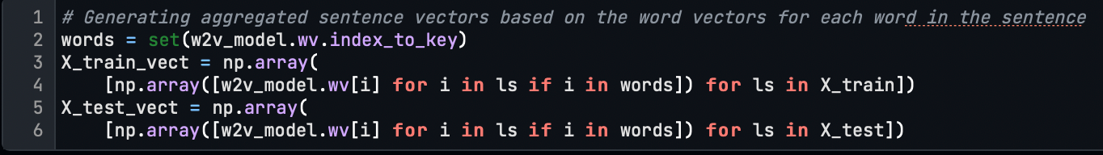
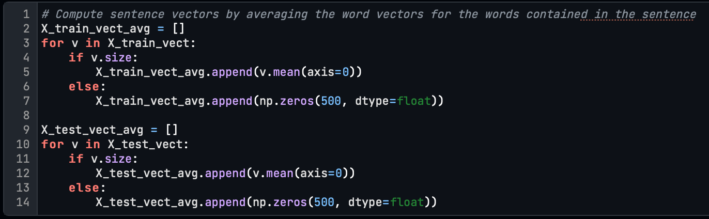
Word2Vec
Word2vec is a technique for natural language processing to convert words into vectors. The word2vec algorithm uses a neural network model to learn word associations from a large corpus of text. Once trained, such a model can detect synonymous words or suggest different words for a partial sentence.
Here we have taken the lemmatized_words for training the network.
We have trained the word2vec model using Gensim’s Word2Vec function with vector_size=500 and window=100 with a min_count of 20.
Generated aggregated sentence vectors based on the word vectors for each word in the sentence
Compute final sentence vectors by averaging the word vectors for the words contained in the sentence

Slide 18
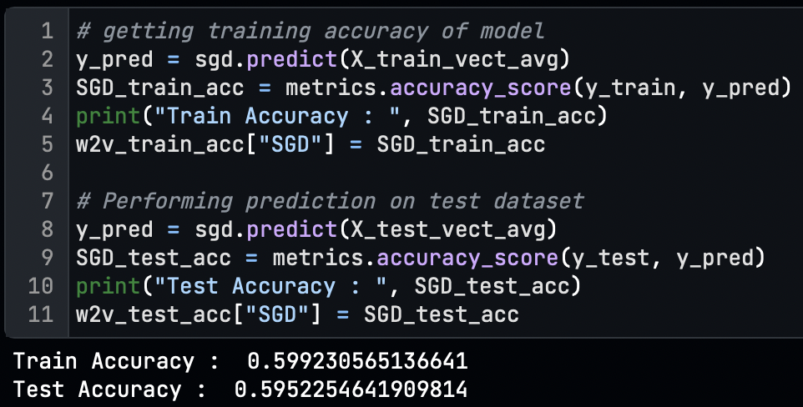
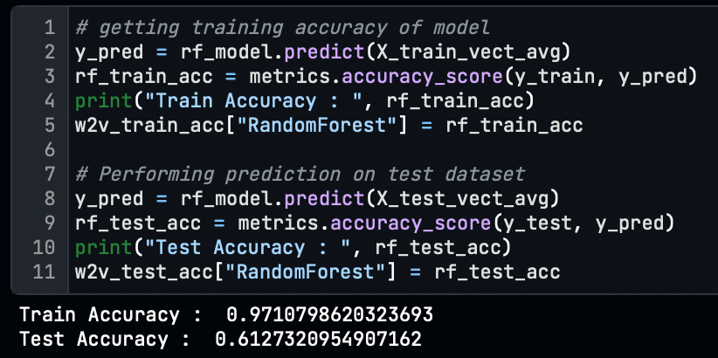
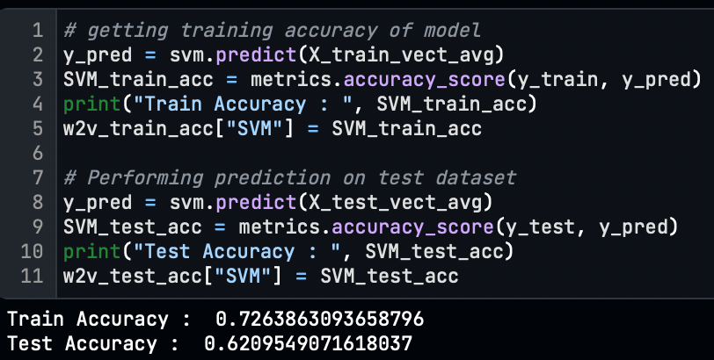
Word2Vec Model Training
We have performed model training with three different classifiers.
Stochastic Gradient Descent(SGD) Classifier
Random Forest Classifier
Support Vector Machine(SVM) Classifier

Slide 19
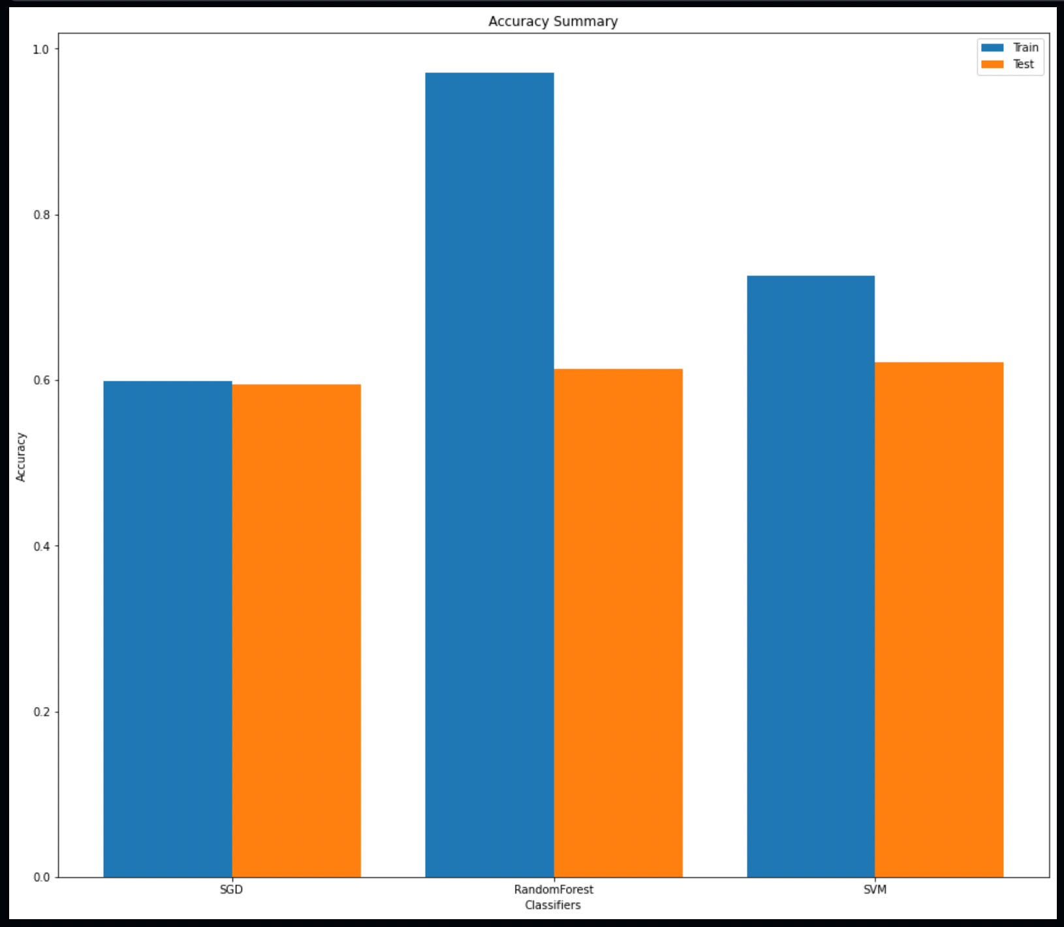
Train-Test Summary
For the word2vec word embedding technique from all three classification models, the Support Vector Machine classifier performed well with the train-test, 73%-61% accuracy score.

Slide 20
Conclusion
To conclude, we performed classification on 20 newsgroup datasets with 2 different word embedding techniques with all text pre-processing steps with feature selection to train the classification models.
We observe that the TF-IDF vectorization technique performed better for this problem, with a 71% accuracy score higher than Word2Vec embedding using the SVM Classifier.
Because the Word2Vec technique is most suitable for recommendation problems, but this is the problem of Multiclass text classification, so for that TI-IDF is best.

Slide 21

Thank You

